Slide 1
Confidence interval
Summarized
Prepared by: CHEA Makara

Slide 2
CI for population mean
CI for population variance
CI for population proportion
Confidence Interval (CI)

Slide 3
CI for population mean
Normal distribution
If $σ^{2} \left(variance\right)is known$
If 𝜎^2 (𝑣𝑎𝑟𝑖𝑎𝑛𝑐𝑒)𝑖𝑠 𝑘𝑛𝑜𝑤𝑛
If $σ^{2} is unknown$
If 𝜎^2 𝑖𝑠 𝑢𝑛𝑘𝑛𝑜𝑤𝑛
Not normal distribution
$$CI=\left[\overline{x}±z_{\frac{α}{2}}\frac{σ}{\sqrt{n}}\right]$$
𝐶𝐼=[𝑥 ̅±𝑧_(𝛼/2) 𝜎/√𝑛]
$$CI=\left[\overline{x}±t_{\frac{α}{2},n−1}\frac{S}{\sqrt{n}}\right]$$
𝐶𝐼=[𝑥 ̅±𝑡_(𝛼/2,𝑛−1) 𝑆/√𝑛]
If $σ^{2} is known and n≥30$
If 𝜎^2 𝑖𝑠 𝑘𝑛𝑜𝑤𝑛 𝑎𝑛𝑑 𝑛≥30
$$CI=\left[\overline{x}±z_{\frac{α}{2}}\frac{σ}{\sqrt{n}}\right]$$
𝐶𝐼=[𝑥 ̅±𝑧_(𝛼/2) 𝜎/√𝑛]
If $σ^{2} is unknown and n≥30$
If 𝜎^2 𝑖𝑠 𝑢𝑛𝑘𝑛𝑜𝑤𝑛 𝑎𝑛𝑑 𝑛≥30
$$CI=\left[\overline{x}±z_{\frac{α}{2}}\frac{S}{\sqrt{n}}\right]$$
𝐶𝐼=[𝑥 ̅±𝑧_(𝛼/2) 𝑆/√𝑛]

Slide 4
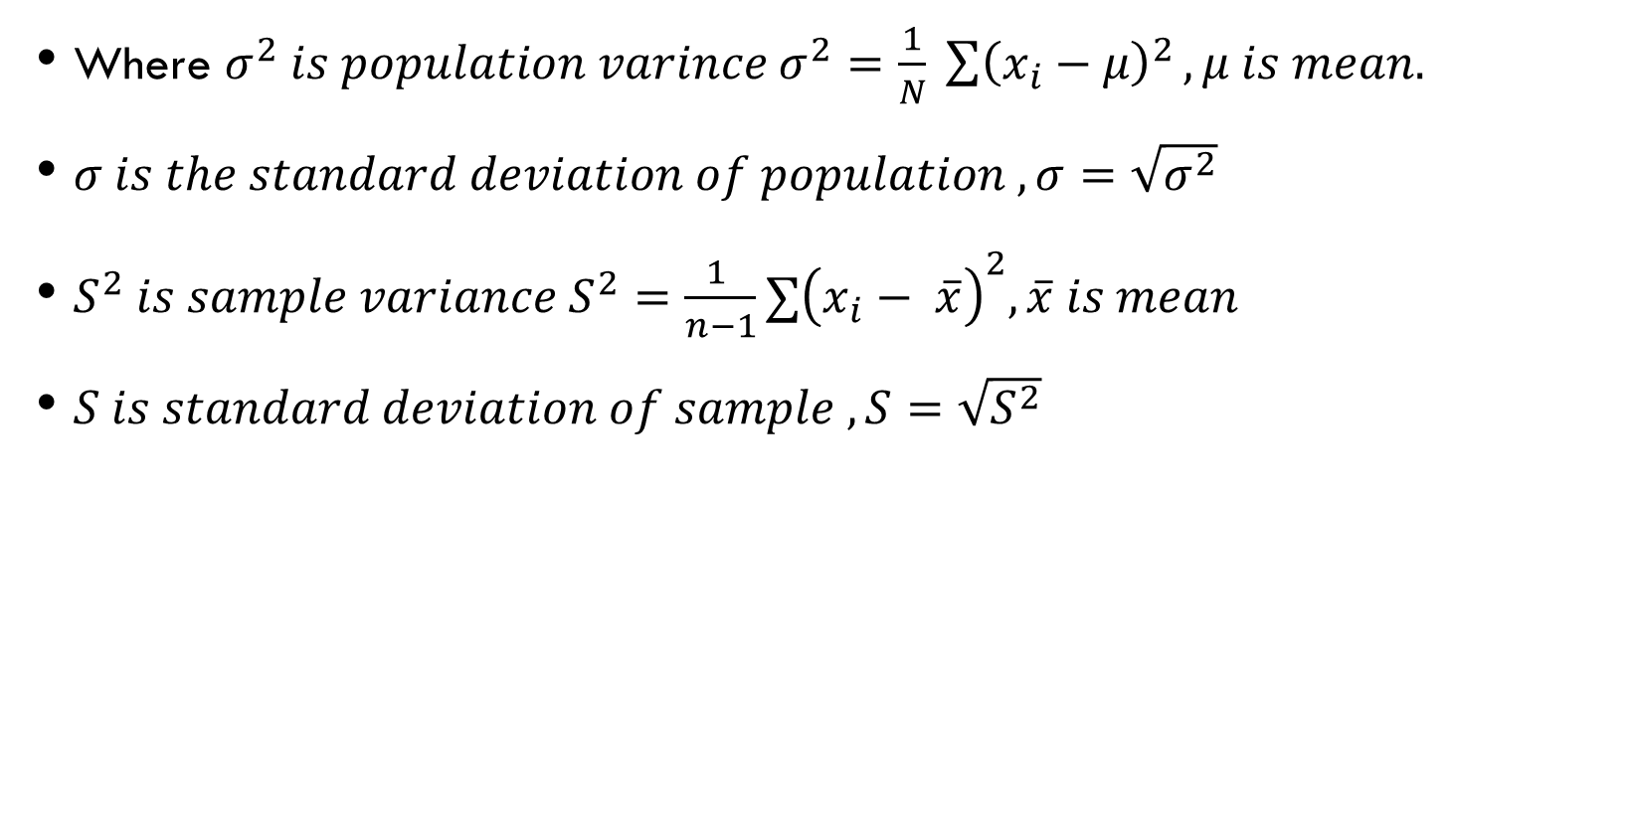
Where $σ^{2} is population varince σ^{2}=\frac{1}{N} \sum{{\left(x_{i}−μ\right)}^{2}}, μ is mean.$
$σ is the standard deviation of population , σ=\sqrt{σ^{2}}$
$S^{2} is sample variance S^{2}=\frac{1 }{n−1}∑{\left(x_{i}− \overline{x}\right)}^{2}, \overline{x} is mean$
$S is standard deviation of sample , S=\sqrt{S^{2}}$

Slide 5


Find minimum sample size $n={\left(\frac{z_{\frac{α}{2}} σ}{E}\right)}^{2}, E is the margin of error$
Example
If you see the word $within 0.2$
Within 0.2 =$(−0.2, 0.2)$
It means $E=0.2$
$$\overline{x}$$
E
E
W=2E

Slide 6
CI for population variance
If $μ is known and σ^{2} is unkwoun$
If 𝜇 𝑖𝑠 𝑘𝑛𝑜𝑤𝑛 𝑎𝑛𝑑 𝜎^2 𝑖𝑠 𝑢𝑛𝑘𝑤𝑜𝑢𝑛
$$CI=\left[\frac{∑{\left(x_{i}−μ\right)}^{2}}{χ_{\frac{α}{2},n}^{2}},\frac{∑{\left(x_{i}−μ\right)}^{2}}{χ_{1−\frac{α}{2},n}^{2}}\right]$$
𝐶𝐼=[(∑(𝑥_𝑖−𝜇)^2)/(𝜒_(𝛼/2,𝑛)^2 ),(∑(𝑥_𝑖−𝜇)^2)/(𝜒_(1−𝛼/2,𝑛)^2 )]
If $μ and σ^{2} are unkown$
If 𝜇 𝑎𝑛𝑑 𝜎^2 𝑎𝑟𝑒 𝑢𝑛𝑘𝑜𝑤𝑛
$CI=\left[\frac{∑{\left(x_{i}−\overline{x}\right)}^{2}}{χ_{\frac{α}{2},n−1}^{2}},\frac{∑{\left(x_{i}− \overline{x}\right)}^{2}}{χ_{1−\frac{α}{2},n−1}^{2}}\right]$
𝐶𝐼=[(∑(𝑥_𝑖−𝑥 ̅ )^2)/(𝜒_(𝛼/2,𝑛−1)^2 ),(∑(𝑥_𝑖− 𝑥 ̅ )^2)/(𝜒_(1−𝛼/2,𝑛−1)^2 )]
=$\left[\frac{\left(n−1\right)S^{2}}{χ_{\frac{α}{2},n−1}^{2}}, \frac{\left(n−1\right)S^{2}}{χ_{1−\frac{α}{2},n−1}^{2}}\right]$
=[((𝑛−1) 𝑆^2)/(𝜒_(𝛼/2,𝑛−1)^2 ), ((𝑛−1) 𝑆^2)/(𝜒_(1−𝛼/2,𝑛−1)^2 )]

Slide 7
CI for population proportions
$CI=\left[\hat{p}±z_{\frac{α}{2}}\sqrt{\frac{\hat{p}\left(1−\hat{p}\right)}{n}} \right]$
𝐶𝐼=[𝑝 ̂±𝑧_(𝛼/2) √((𝑝 ̂(1−𝑝 ̂ ))/𝑛) ]
Where $\hat{p}=\frac{X}{n}∈\left(0,1\right) , probability of success$
Where 𝑝 ̂=𝑋/𝑛∈(0,1) , 𝑝𝑟𝑜𝑏𝑎𝑏𝑖𝑙𝑖𝑡𝑦 𝑜𝑓 𝑠𝑢𝑐𝑐𝑒𝑠𝑠

